Slide 1
Introduction of Machine Learning
Chul Min Yeum
Assistant Professor
Civil and Environmental Engineering
University of Waterloo, Canada
CIVE 497 – CIVE 700: Smart Structure Technology
Last updated: 2019-03-25

Slide 2
What is Machine Learning?
Learning is any process by which a system improves performance from experience (Herbert Simon)
Definition by Tom Mitchell (1998):
Machine Learning is the study of algorithm that
improve their performance P
at come task T
with experience E
A well-defined learning task is given by <P, T, E>
model, coefficient
Slide credit: Eric Eaton

Slide 3
Defining the Learning Task
Improve on task T, with respect to performance metric P, based on experience E
T: Playing checkers
P: Percentage of games won against an arbitrary opponent
E: Playing practice games against itself
T: Recognizing hand-written words
P: Percentage of words correctly classified
E: Database of human-labeled images of handwritten words
T: Driving on four-lane highways using vision sensors
P: Average distance traveled before a human-judged error
E: A sequence of images and steering commands recorded while observing a human driver.
T: Categorize email messages as spam or legitimate.
P: Percentage of email messages correctly classified.
E: Database of emails, some with human-given labels
Slide credit: Ray Mooney

Slide 4
Why is Machine Learning Different from Traditional Programming?
Traditional Programming
Data
Computer
Output
Program
Machine Learning
Data
Computer
Program
Output
Slide credit: Pedro Domingos

Slide 5
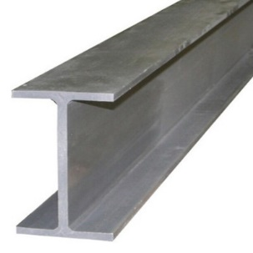
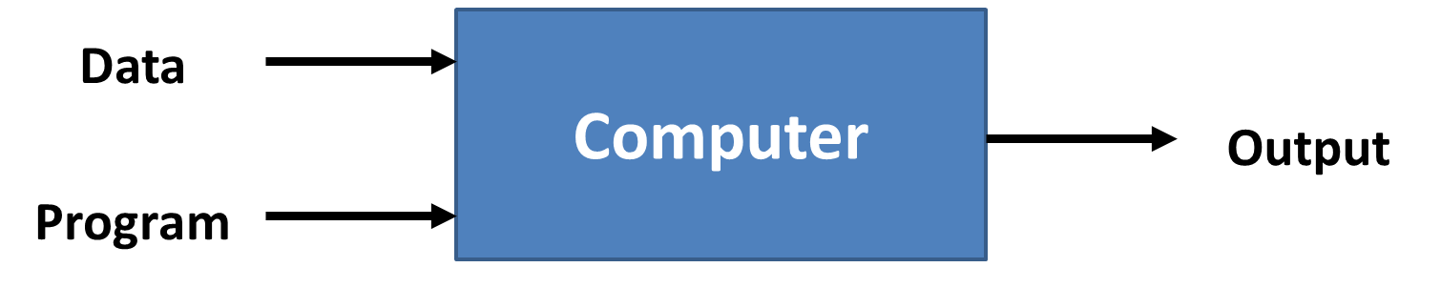
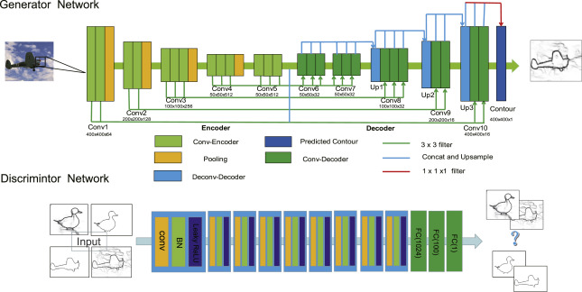
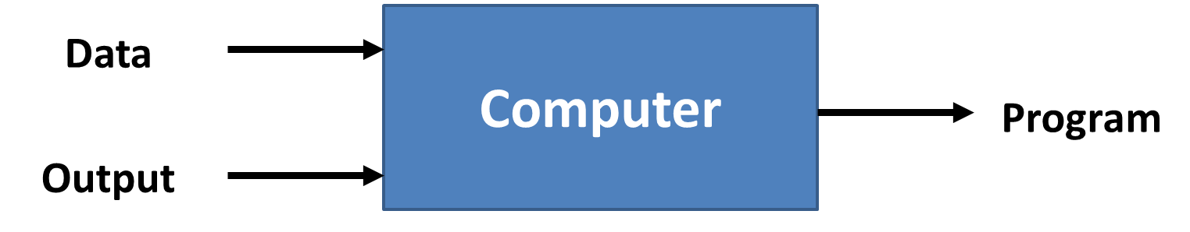
Example: H Beam Classification
Traditional Programming
Edge detection, Hough transform
Machine Learning

Slide 6

Example: Image-to-Image Translation with Conditional Adversarial Nets
https://phillipi.github.io/pix2pix/

Slide 7
Why do We Use Machine Learning?
ML is used when:
Human expertise does not exist (navigating on Mars)
Humans can’t explain their expertise (speech recognition, image recognition)
Models are based on huge amounts of data (genomics), which have complex patterns.
Slide credit: E. Alpaydin

Slide 8
Sample Applications
Web search
Computational biology
Finance
E-commerce
Space exploration
Robotics
Information extraction
Social network
Debugging Software
Inspection
What are your applications?
Slide credit: Pedro Domingos

Slide 9
Types of Learning
• Supervised (inductive) learning
– Given: training data + desired outputs (labels)
• Unsupervised learning
– Given: training data (without desired outputs)
• Semi-supervised learning
– Given: training data + a few desired outputs
• Reinforcement learning
– Rewards from sequence of actions
Based on slide by Pedro Domingos

Slide 10
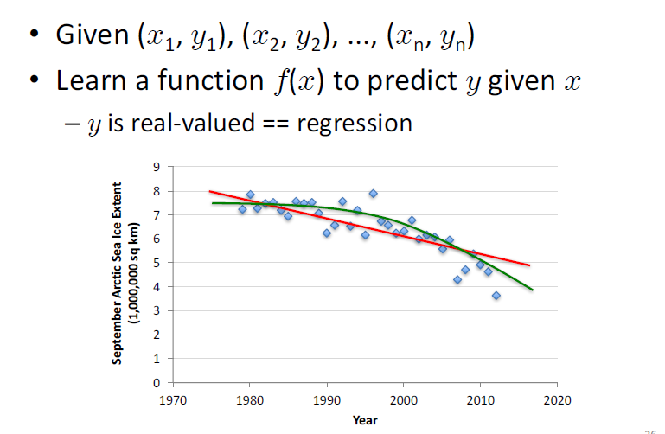
Supervised Learning: Regression
Data from G. Witt. Journal of Statistics Education, Volume 21, Number 1 (2013)

Slide 11
Revisit: Line Fitting
Data (measurement): (x₁, y₁), …, (x_{n}, y_{n})
Y
Known model: Line (y_{i} = m x_{i} + b)
We will find m and b.
Your data
0
X

Slide 12
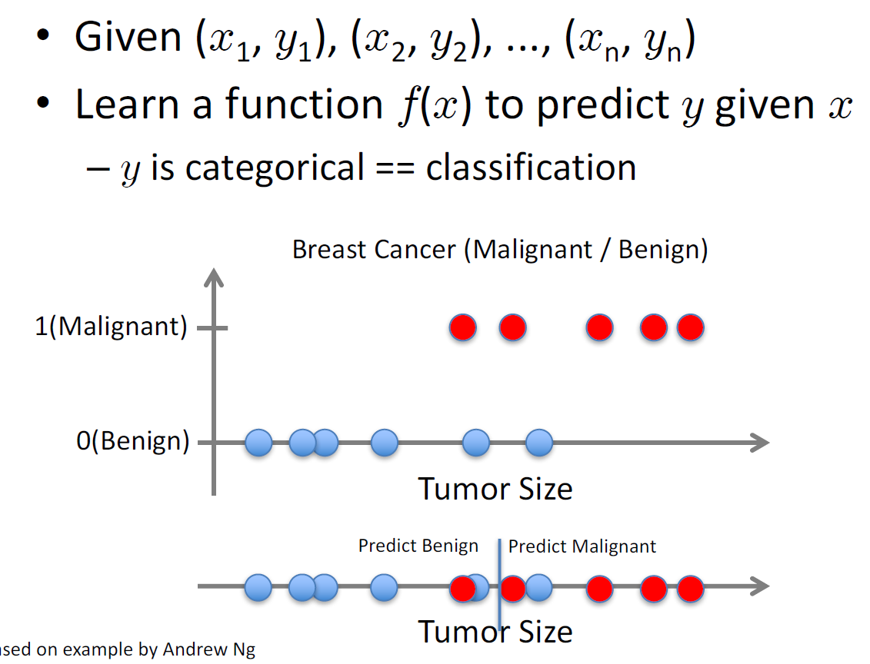
Supervised Learning: Classification
Based on example by Andrew Ng

Slide 13
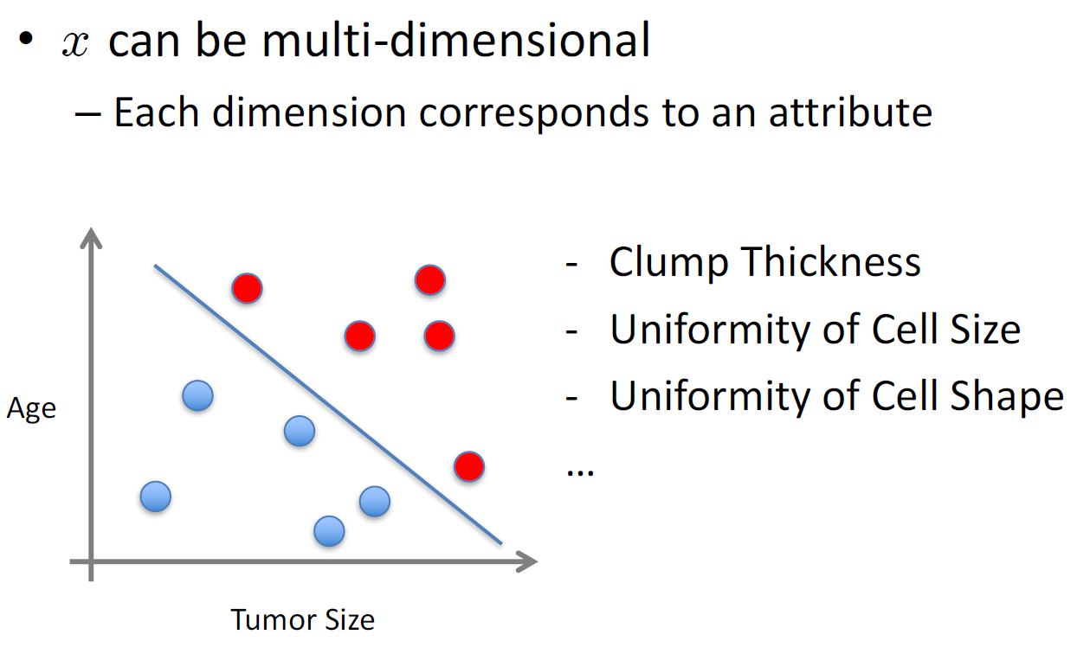
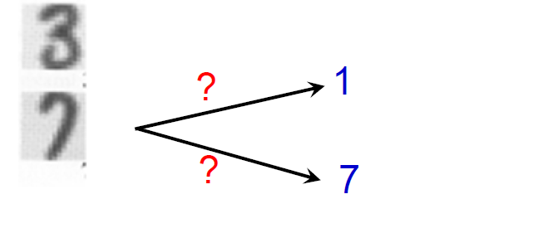
Supervised Learning: Classification
Based on example by Andrew Ng

Slide 14
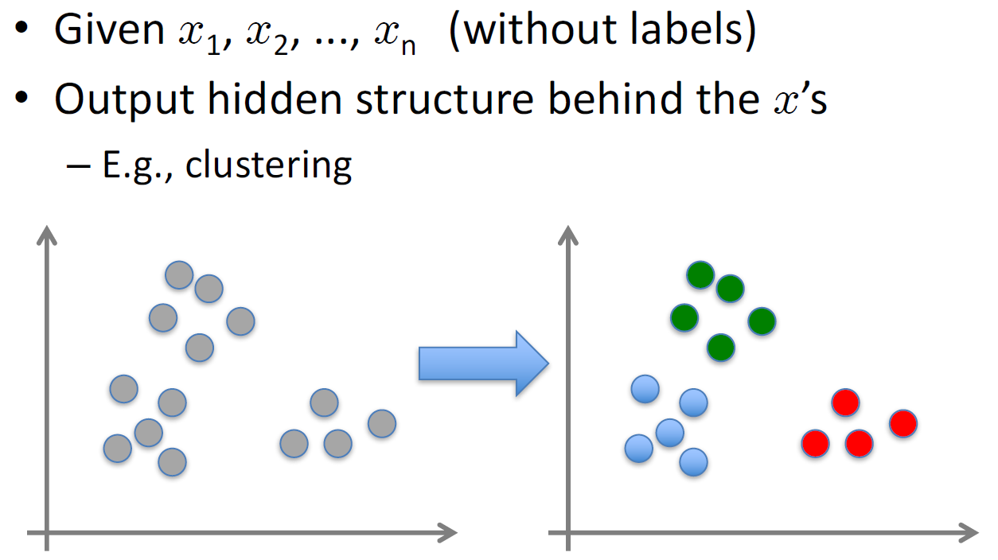
Unsupervised Learning: Clustering

Slide 15
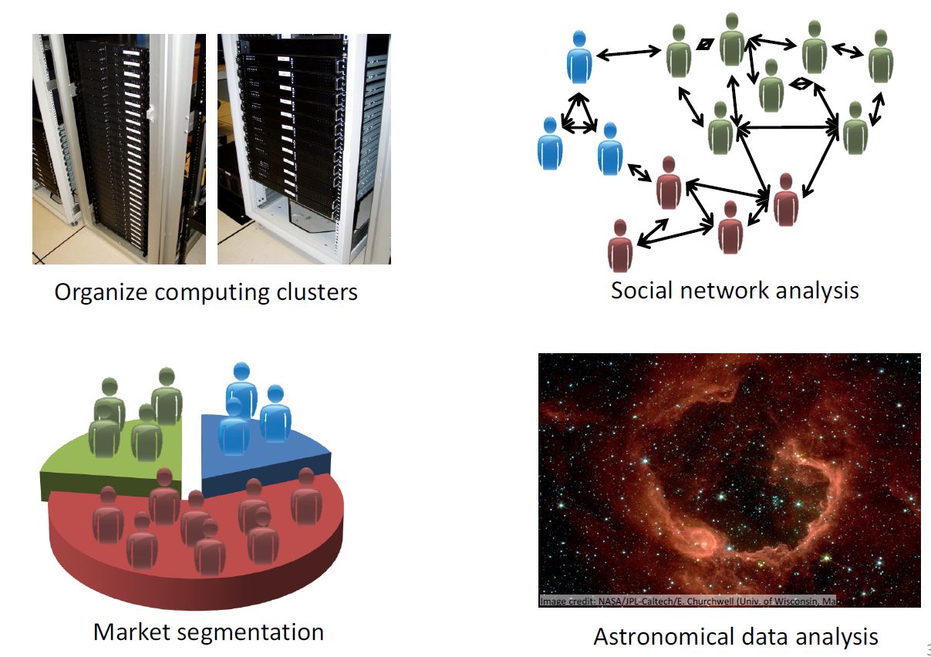
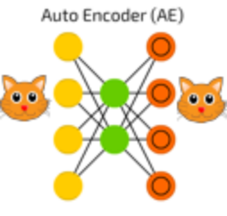
Example: Unsupervised Learning
Autoencoder

Slide 16
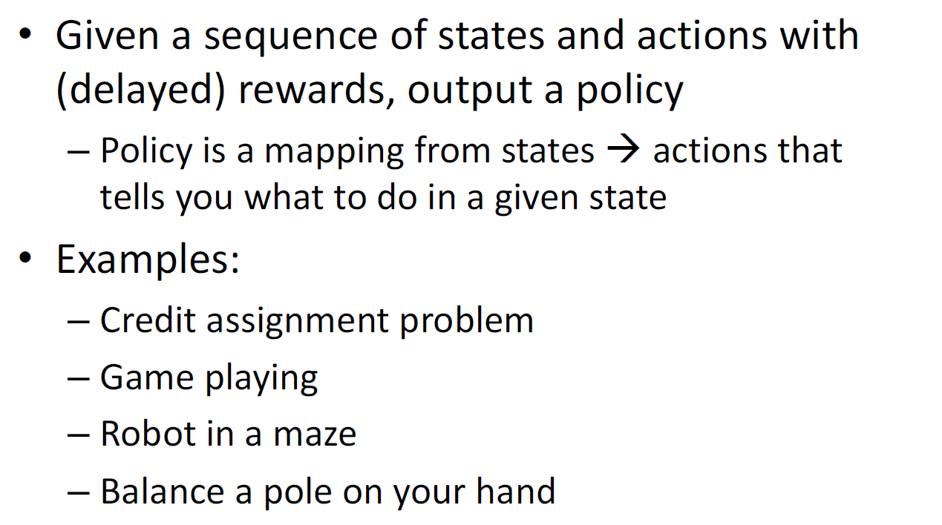
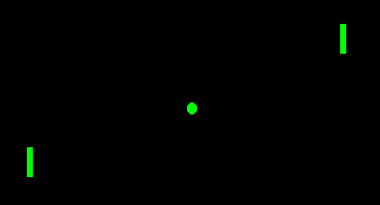
Reinforcement Learning

Slide 17
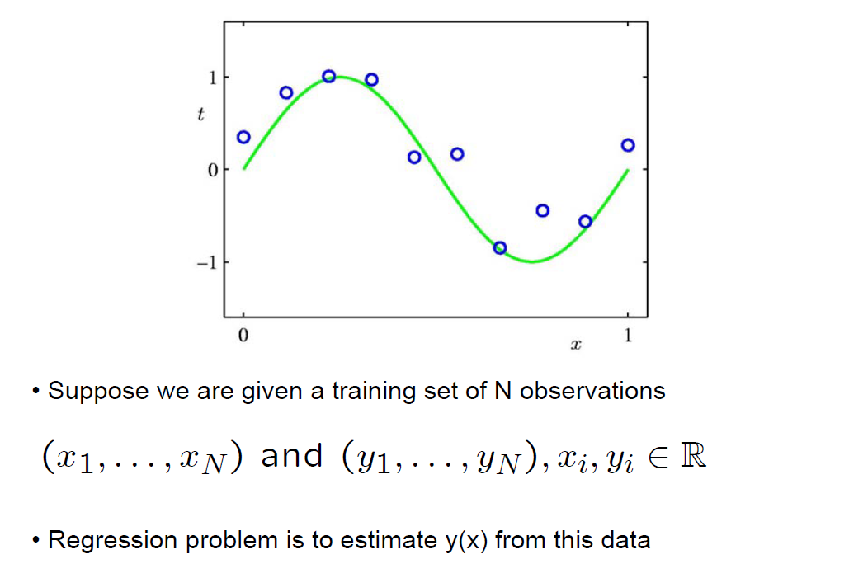
Example: Regression (Supervised Learning)

Slide 18
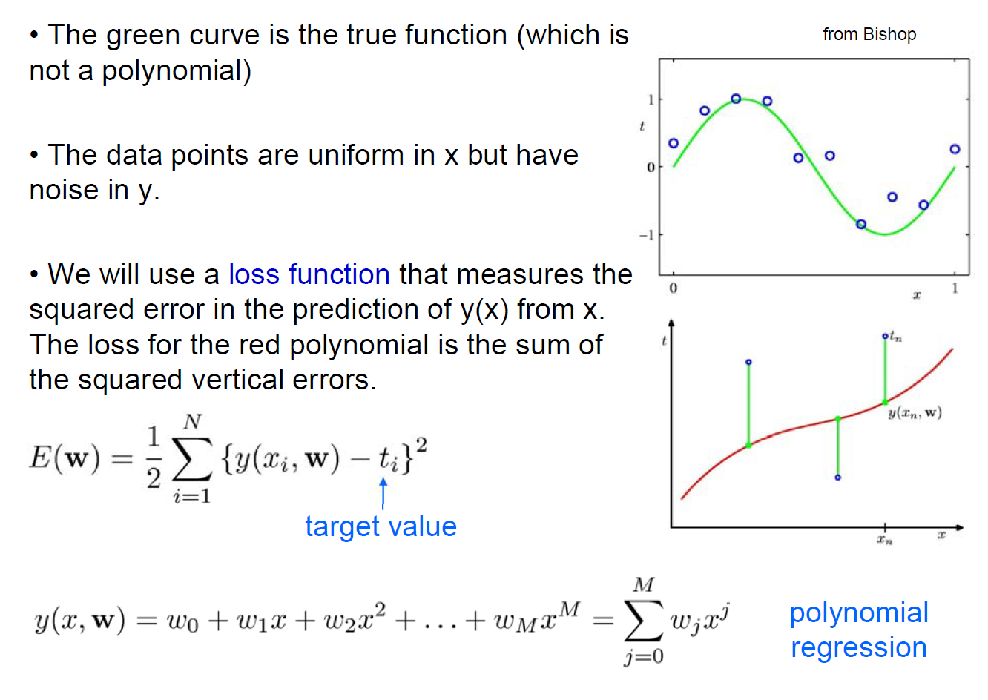
Polynomial Curve Fitting

Slide 19
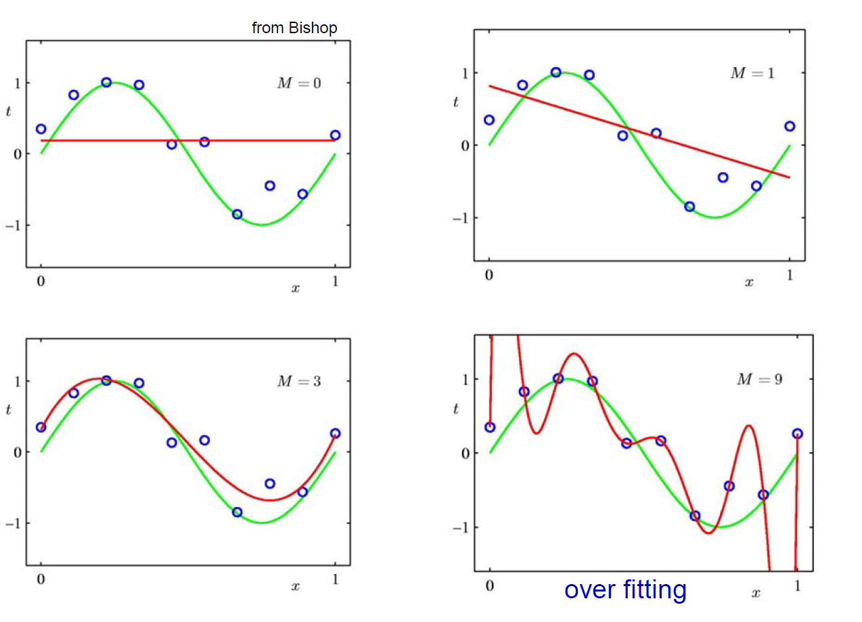
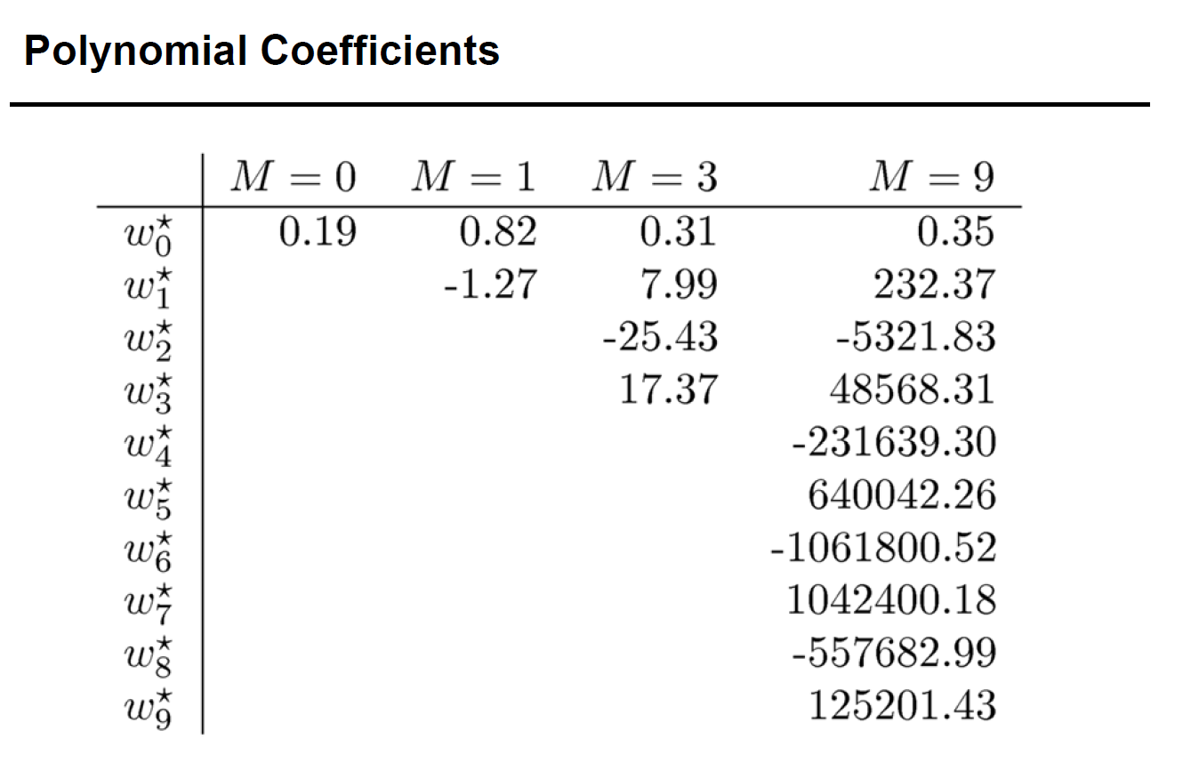
Some Fits to the Data: Which is Best?

Slide 20
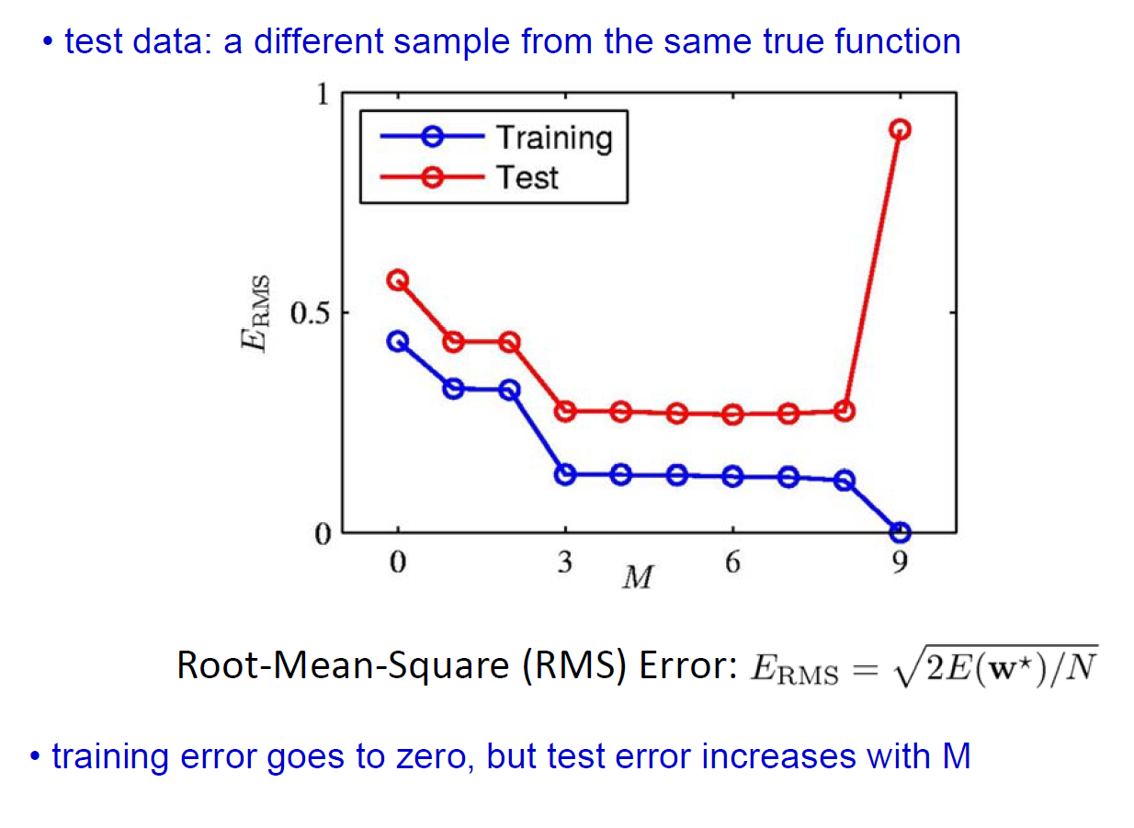
Overfitting

Slide 21
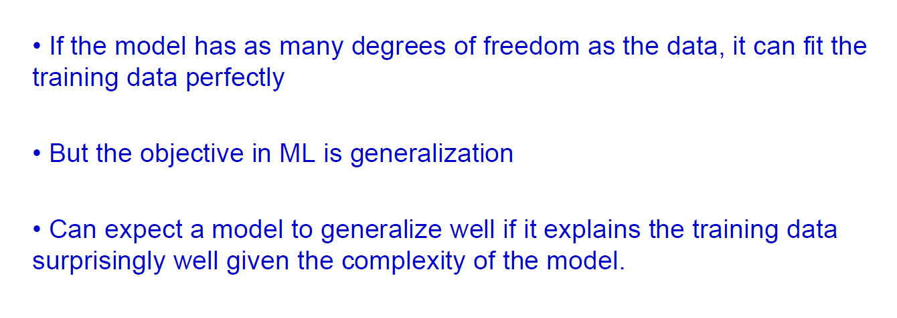
Trading off Goodness of Fit against Model Complexity

Slide 22
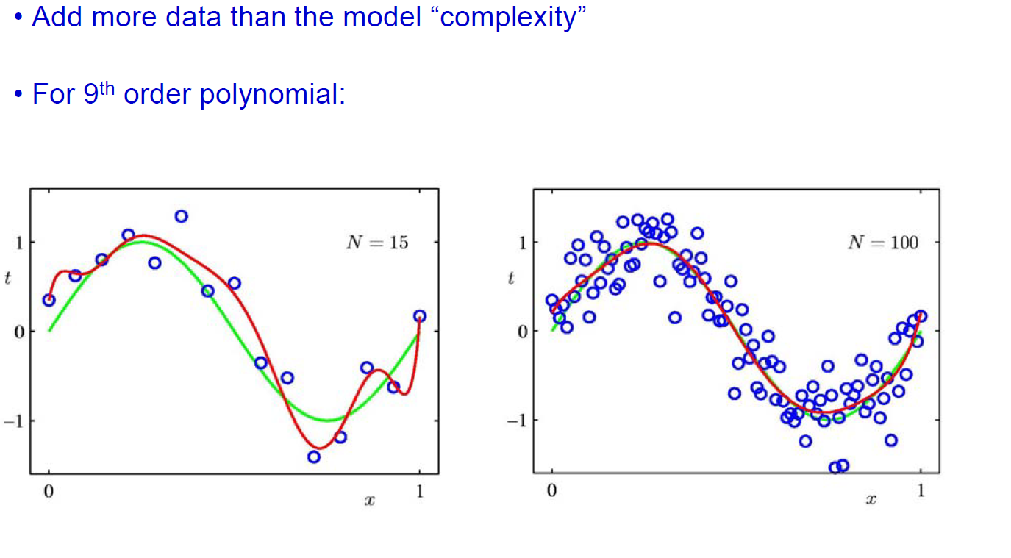
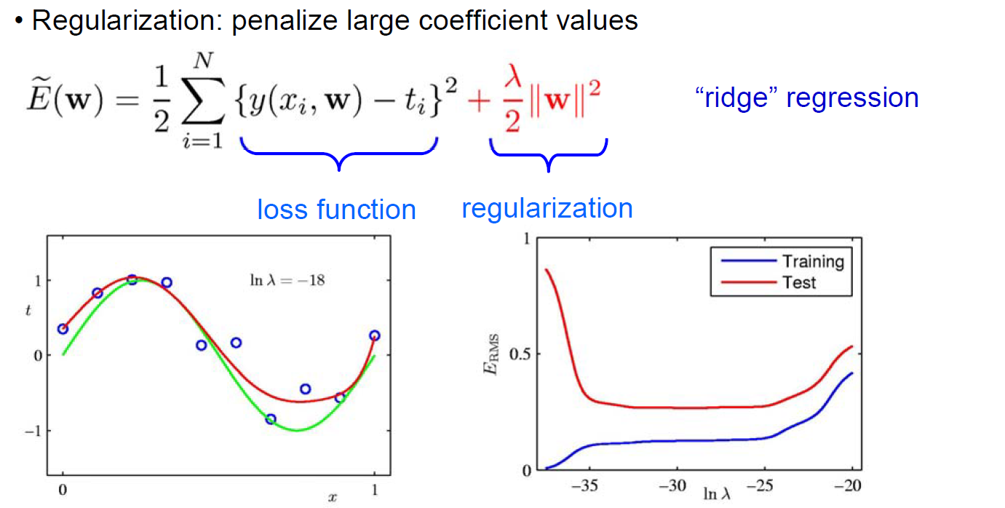
How to Prevent Over-fitting?

Slide 23
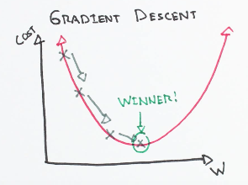

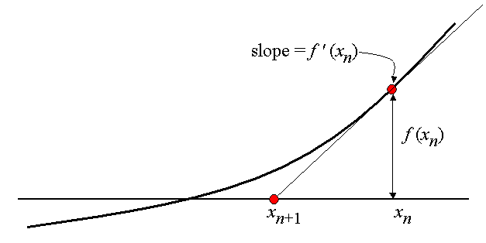
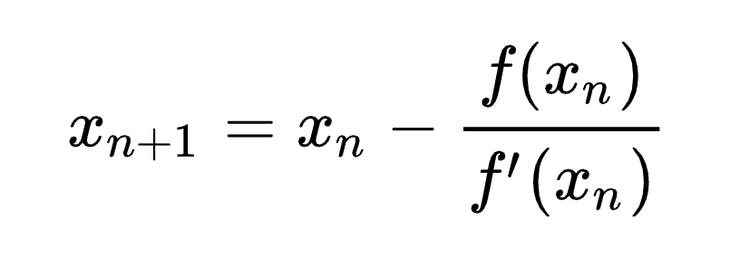
Learning Rate

Slide 24
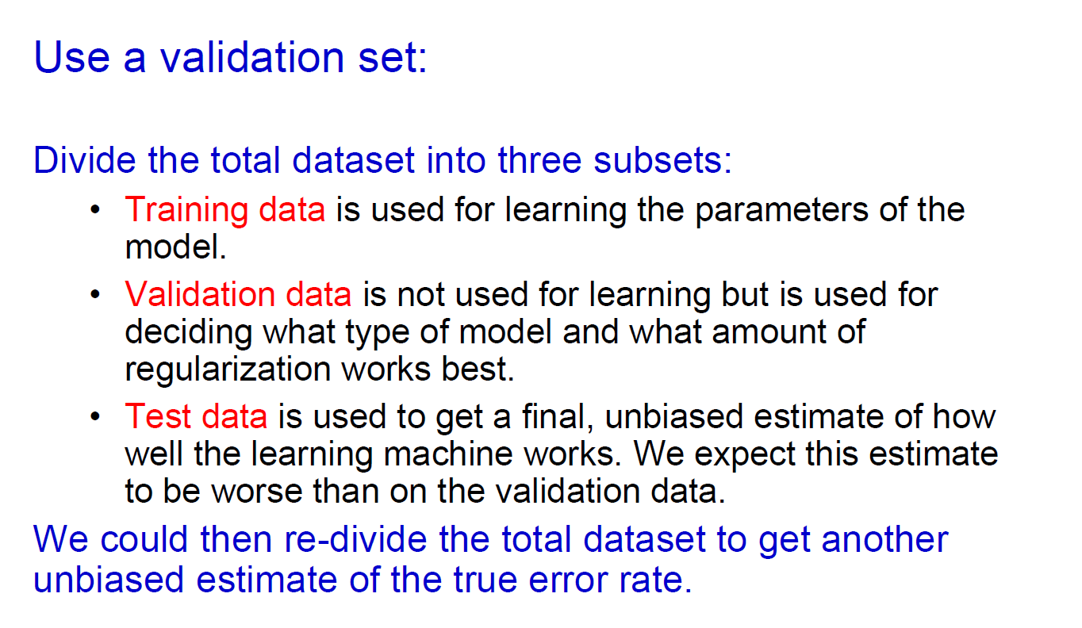
How to Set Parameters

Slide 25
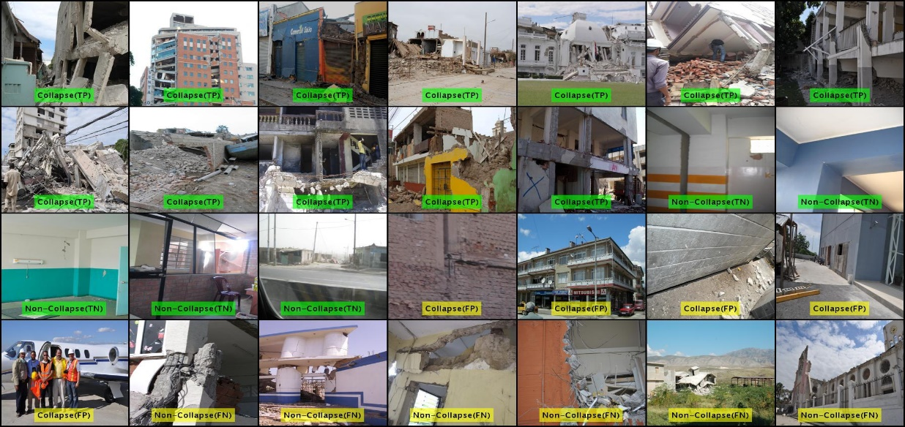
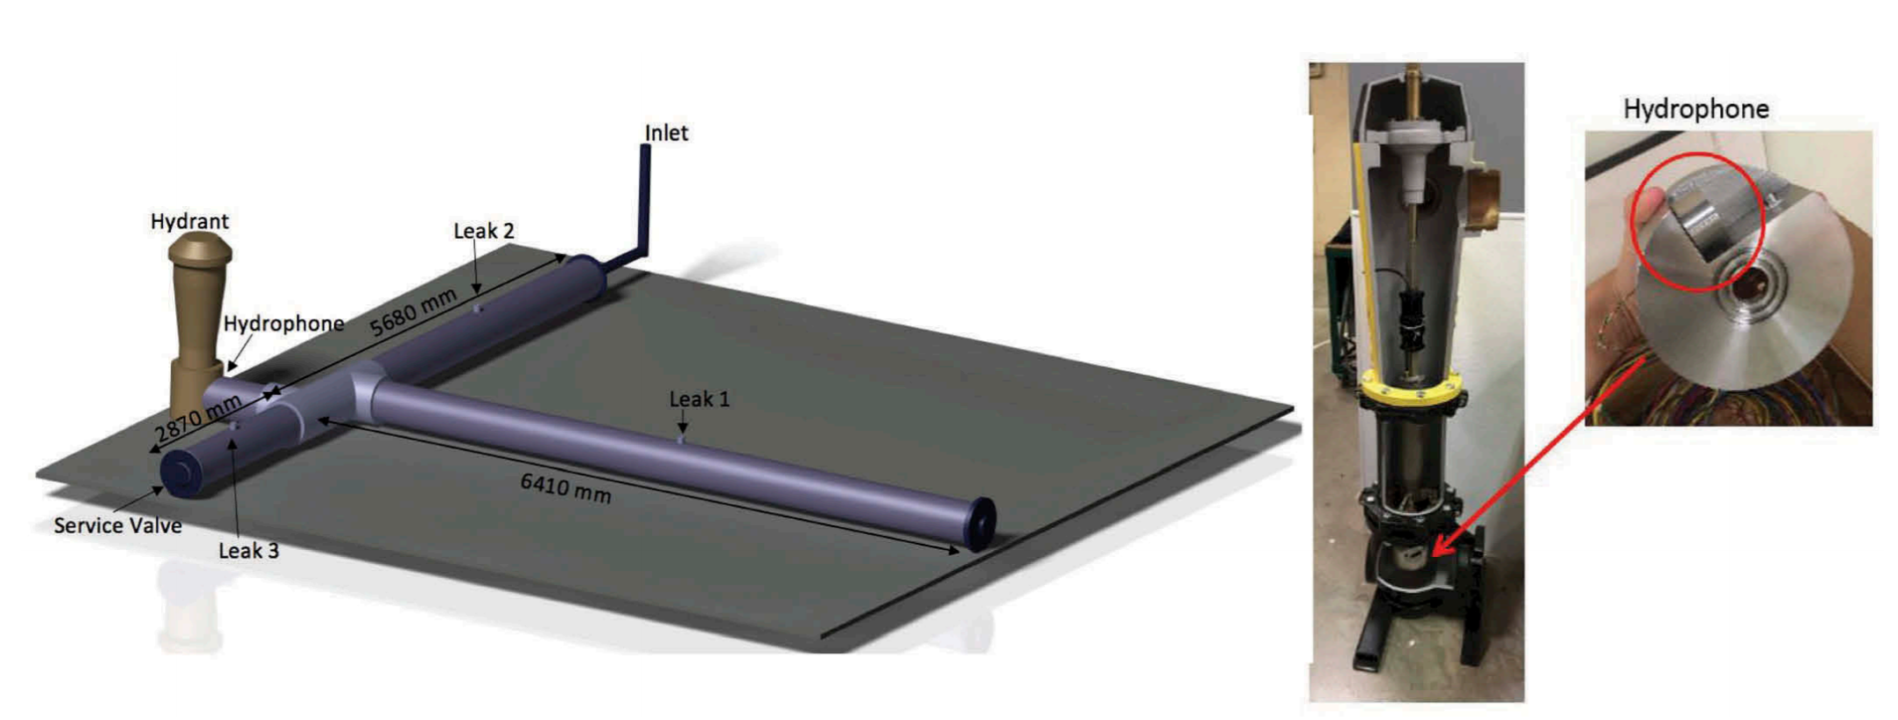
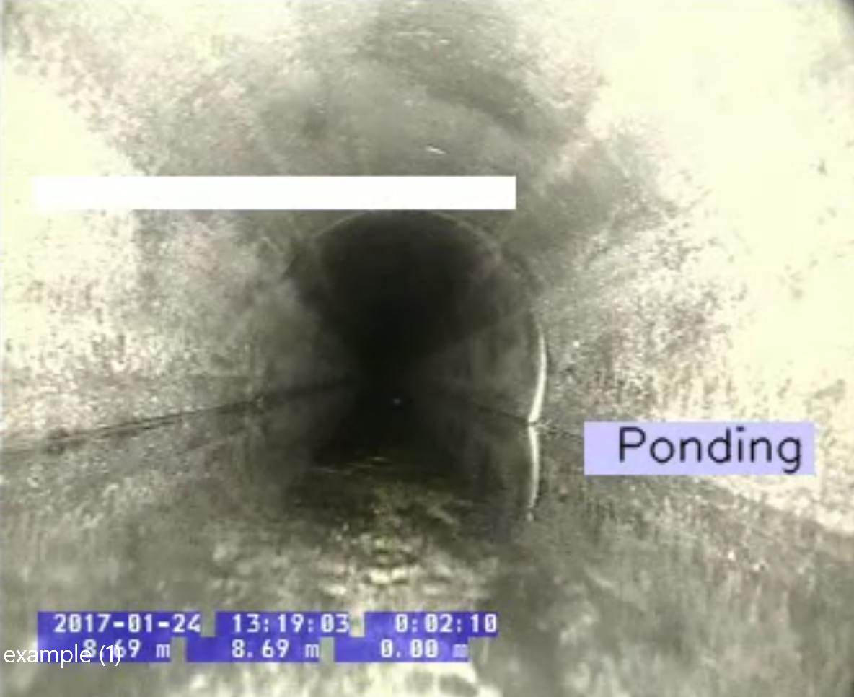
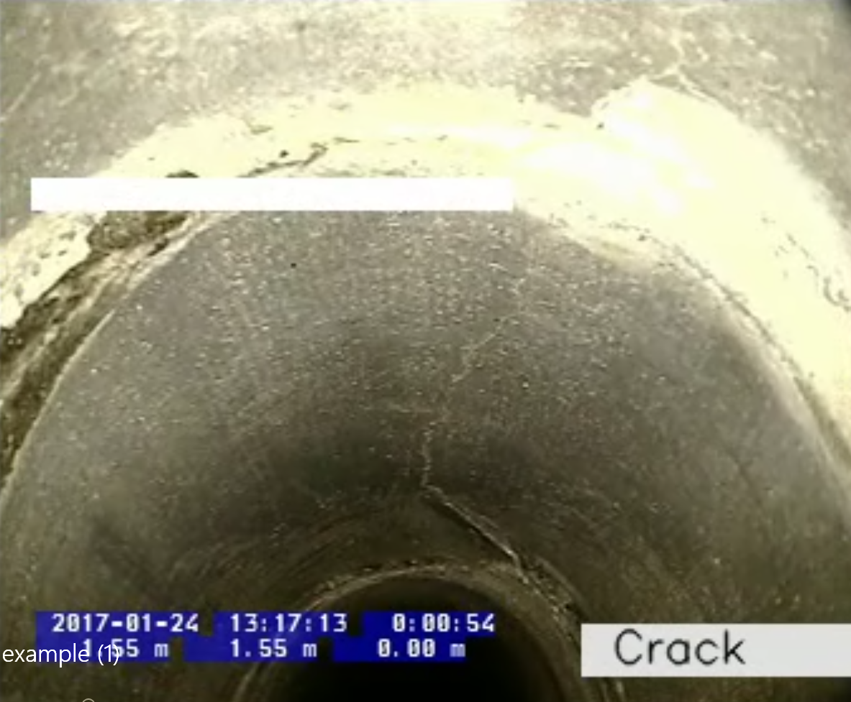
Example: Damage Detection
Supervised
Unsupervised
Semi-supervised
Collapse classification
Leak detection (Cody et al, 2018)
Pipeline inspection

Slide 26
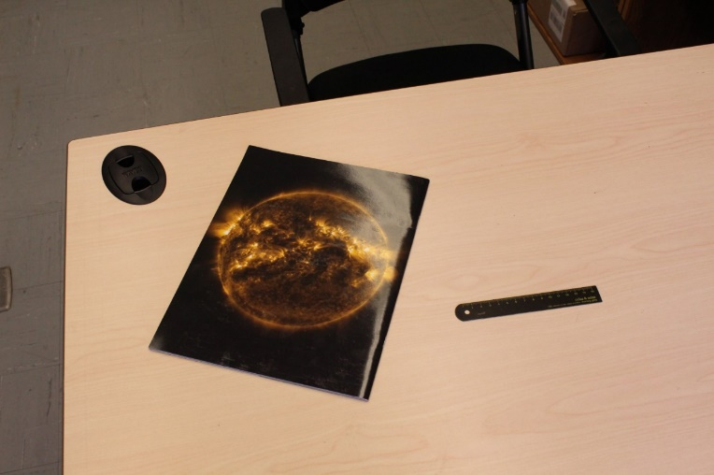
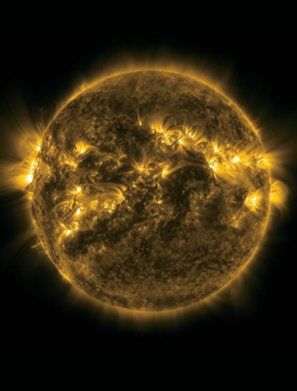
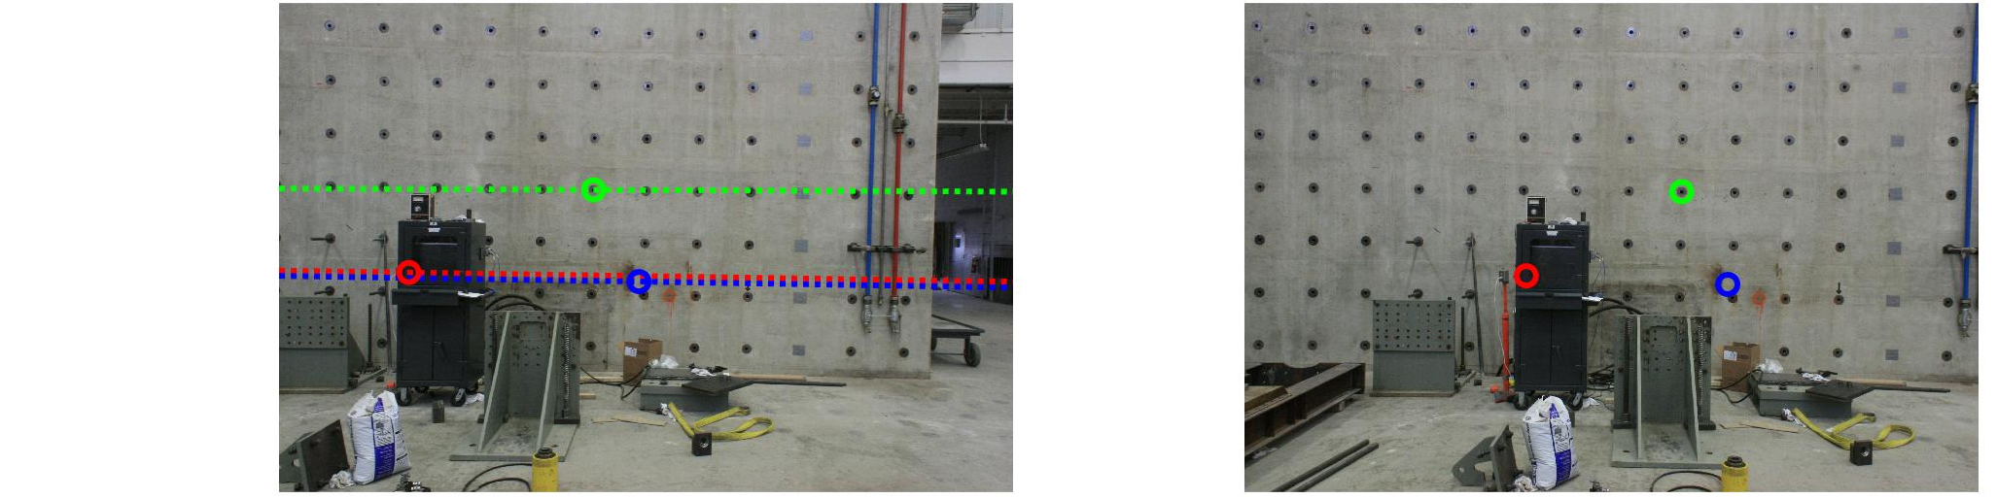
Example: Homography Estimation and Fundamental Matrix

Slide 27
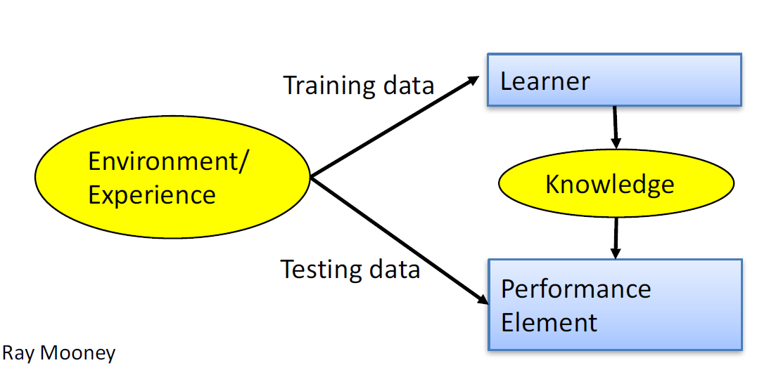
Designing a Learning System
Choose the training experience
Choose exactly what is to be learned
– i.e. the target function
Choose how to represent the target function
Choose a learning algorithm to infer the target function from the experience
Slide credit: Ray Mooney

Slide 28
Machine Learning in Practice
Understand domain, prior knowledge, and goals
Data integration, selection, cleaning, pre-processing, etc.
Learn models
Interpret results
Consolidate and deploy discovered knowledge
Loop
Slide credit: Pedro Domingos

Slide 29
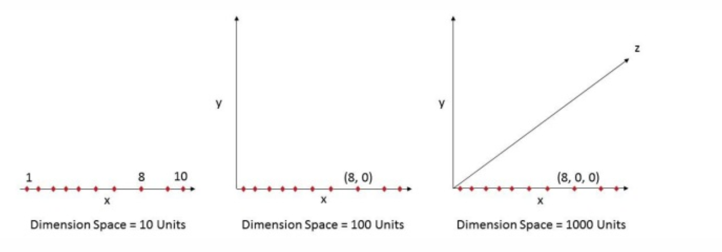
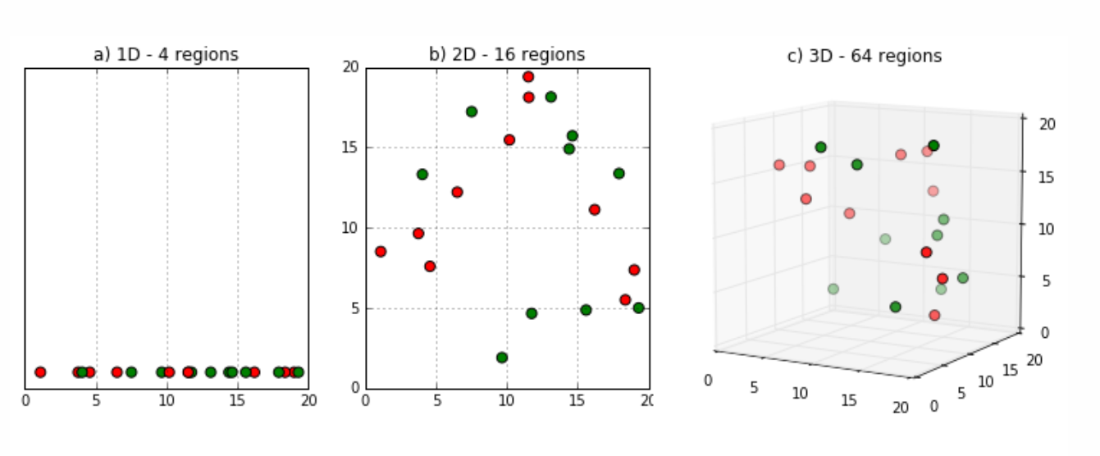
Curse of Dimensionality
"As the number of features or dimensions grows, the amount of data we need to generalize accurately grows exponentially,” Charles Isbell
Think of image recognition problem of high resolution images 1280 × 720 = 921,600 pixels i.e. 921600 dimensions.
That’s why it’s called Curse of Dimensionality. Value added by additional dimension is much smaller compared to overhead it adds to the algorithm.
SIFT Descriptor
https://www.kdnuggets.com/2017/04/must-know-curse-dimensionality.html

Slide 30
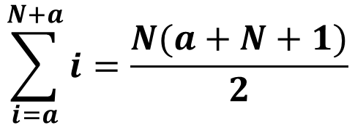
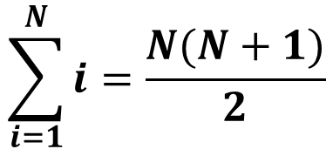
Example: Summation of N Numbers from a to a+N
$$\sum_{i=1}^{N}{i}=\frac{N(N+1)}{2}$$
$$\sum_{i=a}^{N+a}{i}=\frac{N(a+N+1)}{2}$$
How to design your problem?

Slide 31

Q and A

Slide 32
Slide Credits and References
Lecture notes: Eric Eaton
Lecture notes: A. Zisserman
Lecture notes: David Sontag
Bishop (2006) Pattern Recognition and Machine Learning

